Slide 1
Deception Detection using Facial Action Units
Emanuele Orfanelli – Sapienza – Laurea Magistrale in Informatica AA. 2017/2018

Slide 2
Introduction
Deception Detection
Many ways to detect lies
FACS
AUs
Architecture
Dataset
Facial Landmarks
Extraction of Features
Action Unit presence/intensity
SVC
Result
Problems
Future
Thanks

Slide 3

What is Deception Detection?

Slide 4

There are many ways to detect lies
Psychology
Body language, micro-expressions, eye position
Speech analysis
Speed, patterns, words
Neuroscience
EEG, fMRI
Thermal Imaging
More….

Slide 5
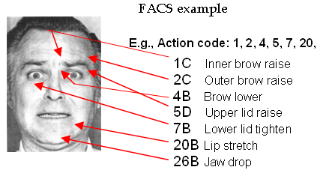
Action Units
Action Units (AU) are a contraction or relaxation of one or more muscles.
AUs can be used to codify emotions through the muscles involved and the intensity of the movement.
Facial Action Coding System manual for such classification.

Slide 6
Facial Action Coding System
Codify all AUs into expressions

Slide 7
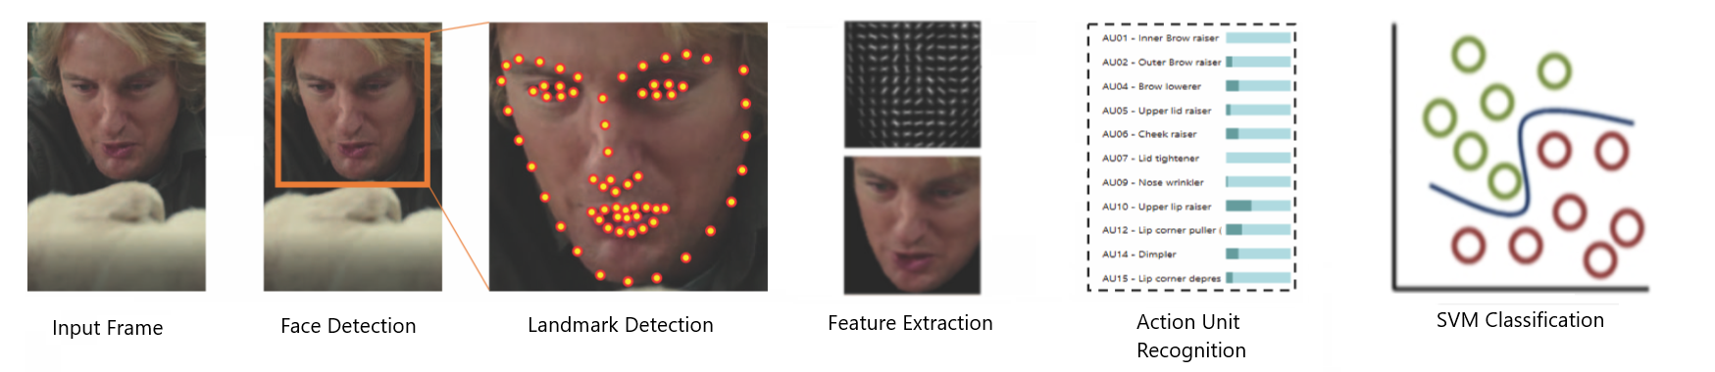
Architecture
Input Video
Face Detection
Landmark Detection
Feature Extraction
AU Recognition
SVM Classification

Slide 8

Video Dataset
Real life trial videos. High stakes.
121 videos.
61 deceptive.
60 truthful.
Defendant or witness can be clearly identified.
Three outcomes to label the videos as deceptive or truthful.
Guilty.
Non-guilty.
Exonerated (reversal of the sentence).
Testimony were verified by police officers.
Work on cutting and removing videos.

Slide 9
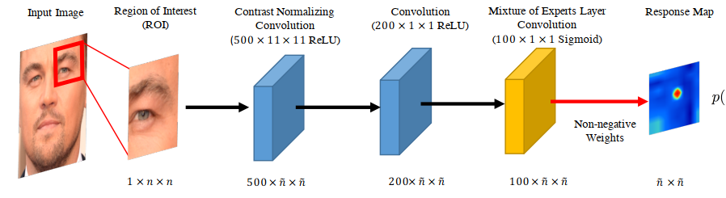
Facial Landmark Detection
Two Phases
Response map computation using Convolutional Experts Network
Shape parameter update
Convolutional Experts Constrained Local Model (CE-CLM)
Convolutional Experts Network as local detector
Computes a response map to accurately localize individual landmarks by evaluating the landmark alignment probability at individual pixel locations.
Individual landmark alignment is estimated independently of the position of other landmarks.
Constrained Local Model for shape parameter update
During the parameter update, the positions of all landmarks are updated jointly and penalized for misaligned landmarks and irregular shapes using a point distribution model
Control the landmark locations and to regularize the shape

Slide 11
Action Unit Detection
Trained on four dataset: ﻿DISFA, BP4D-Spontaneous, SEMAINE and CK+.
Datasets consist of videos of people subject to emotion inducing tasks.
﻿BP4D, SEMAINE and DISFA have three AUs in common: 2, 12, and 17.
SEMAINE and DISFA share AUs 2, 12, 17, 25.
BP4D and DISFA share AUs 1, 2, 4, 6, 12, 15, 17.

Slide 12
Action Unit Detection
Feature Extraction
Appearance Features: Histogram of Oriented Gradients.
Geometry Features: Landmark Location and Shape parameters.
Alignment and Masking
Need for a mapping to a common reference frame.
﻿Similarity transform from the currently detected landmarks to a representation of frontal landmarks from a neutral expression
﻿Masking is performed using a convex hull surrounding the feature points
Results in a 112x112 pixel image of the face

Slide 13
Action Unit Detection
﻿Appearance Features
12x12 block of 31 dimensional Histogram of Oriented Gradients are extracted.
4464 dimensional vector for the face.
PCA to get a vector of 1379 features.
Geometry Features:
Vector of dimension 227 from landmark locations and shape parameters
Total of ﻿1606 features that define the face.

